Slide 1
SURF 2024 – Week 6th Meeting
Ryan Hsieh 2024/06/27

Slide 2
AGENDA
Use of PowersimData
Use of PostREISE

Slide 3
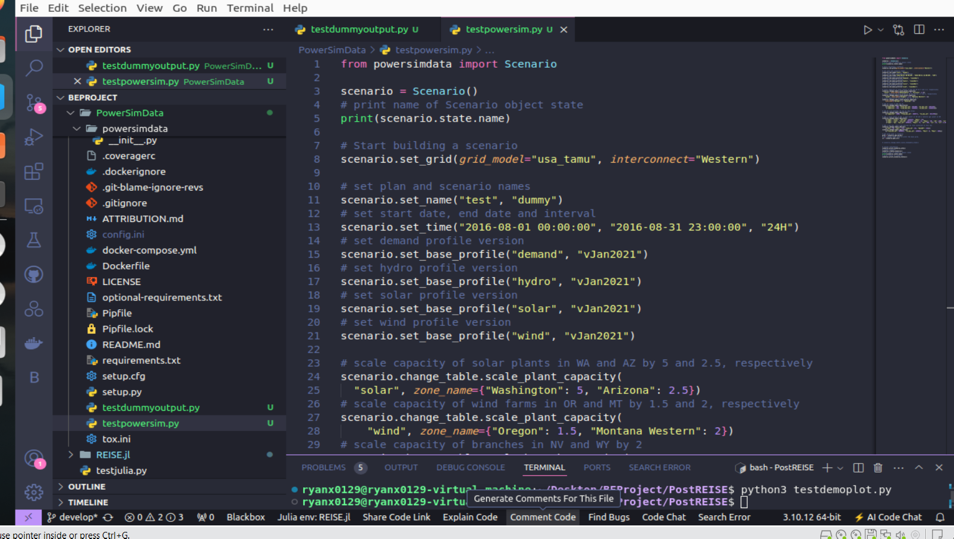
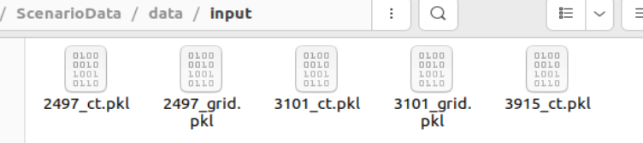
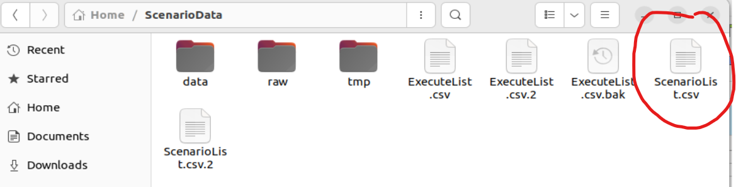
Powersimdata
Create dummy scenario
Appeared in ScenarioData Directory (created by open source)
PowerSimData:
*Generate Scenarios = major use
Generated Scenario will appear in ScenarioList.csv
Default Scenario built will appear in ScenarioList.csv.2
Inputted data will be save in data/input

Slide 4
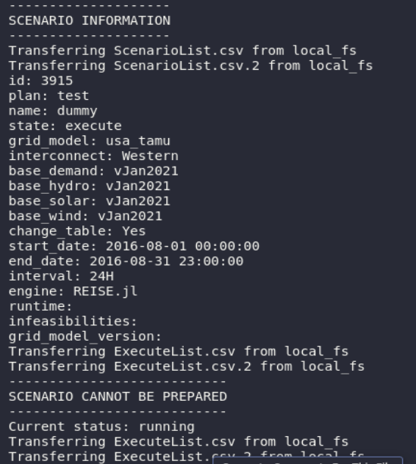
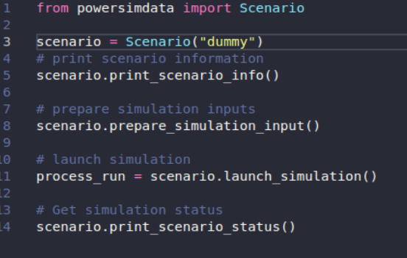
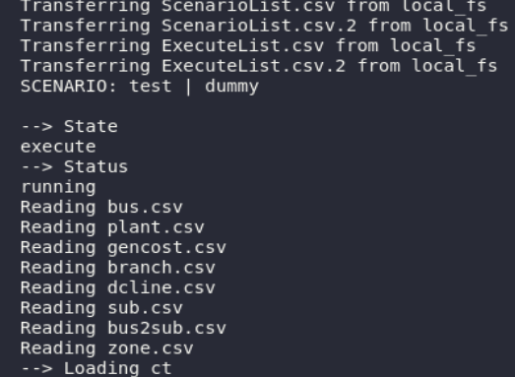
Powersimdata
Scenario Analysis
Based on Scenario Created, information output will alternate
Saved in data/input

Slide 5
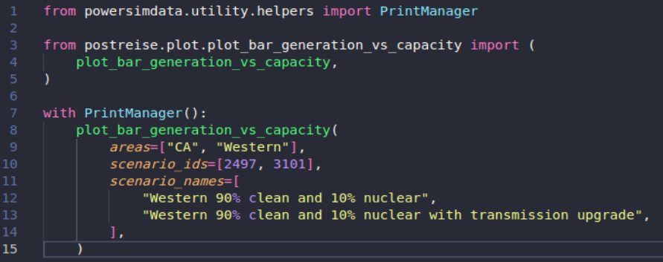
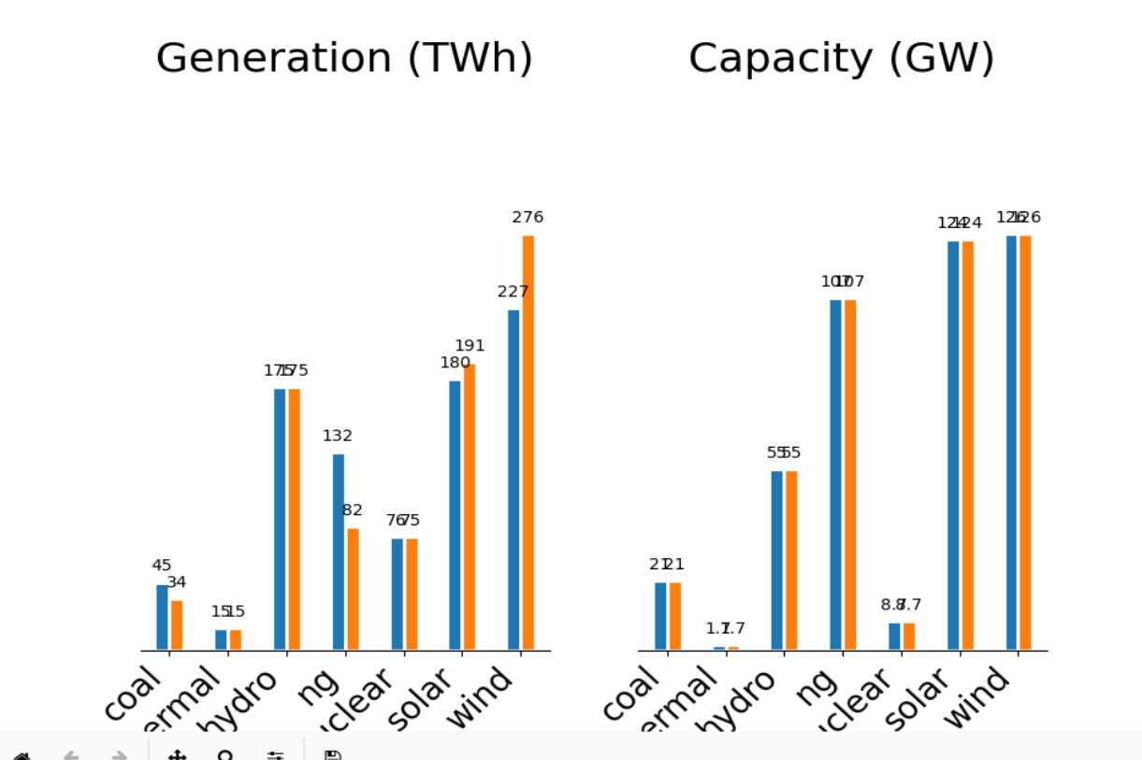
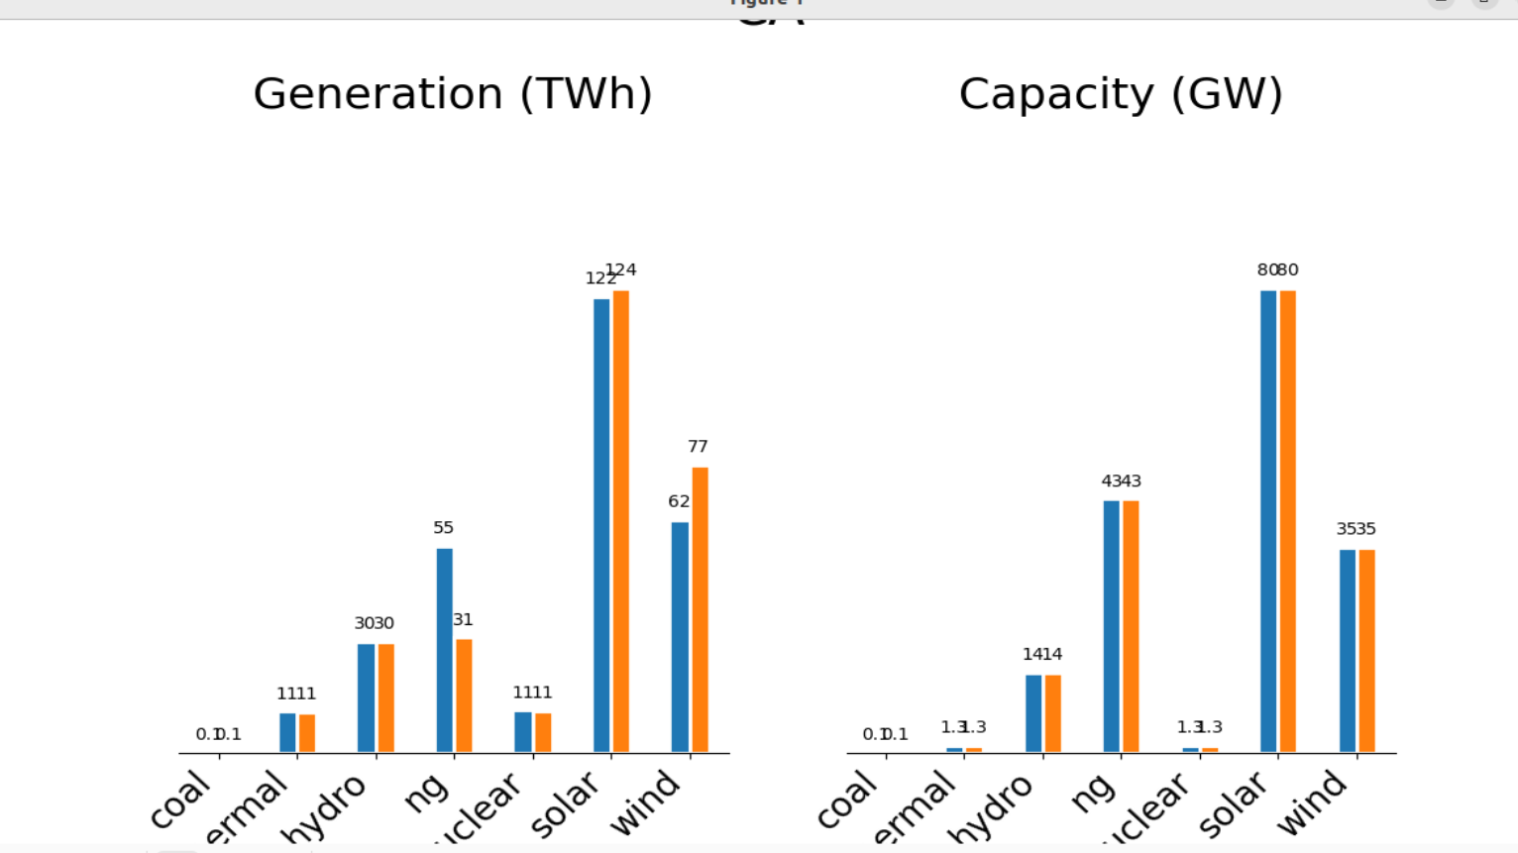
PostREise
PostReise generated plot
These are the sample bar plots for generation vs capacity of all types of energy in CA and Western Region

